Slide 1
The Battle of Neighborhoods - Dylan’s Candy Bar in Paris
Capstone Project

Slide 2
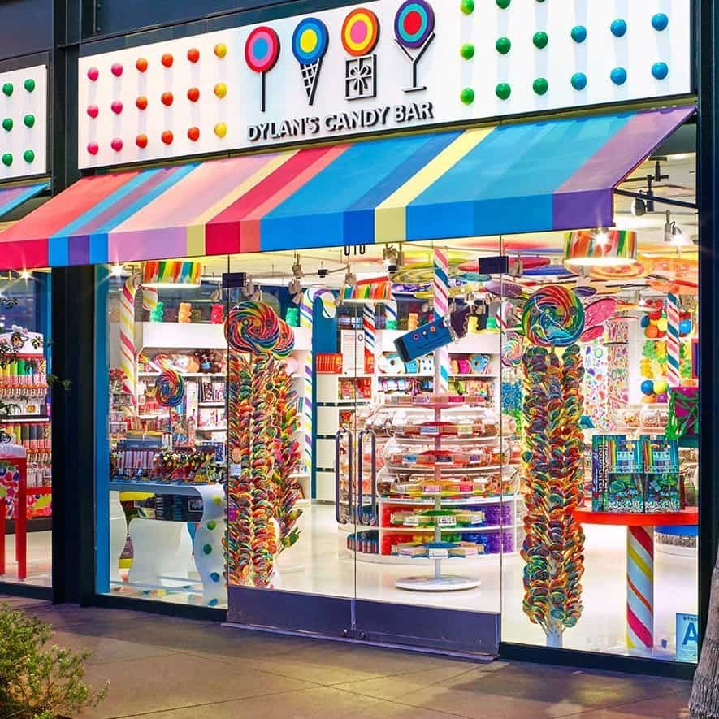
Dylan’s Candy Bar in Paris
The supposition is made that the Dylan’s Candy Bar chain of stores wants to continue to expand internationally. For this reason, they want to open a store in Paris.
As these shops are very colourful like you can see in the photo, children are the target clientele by excellence.
Several stores are already opened in the USA and could be an example of location where a fashion candy bar is likely to open.
Where is the best place for the candy bar to be seen by children ?
Where is the best place to open a fashion candy bar like those already opened in the USA ?
What neighborhoods have such criteria ?

Slide 3
Data acquisition
Data used for the Paris neighborhoods:
Wikipedia: Borough, Neighborhood, Number, Population and density for each neighborhood of Paris
Opendata.Paris: Neighborhood, latitude, longitude and GeoJSON information about the neighborhoods
Data used for Dylan’s Candy Bar:
Dylan’s Candy Bar Website: list and of the stores andtheir address

Slide 4
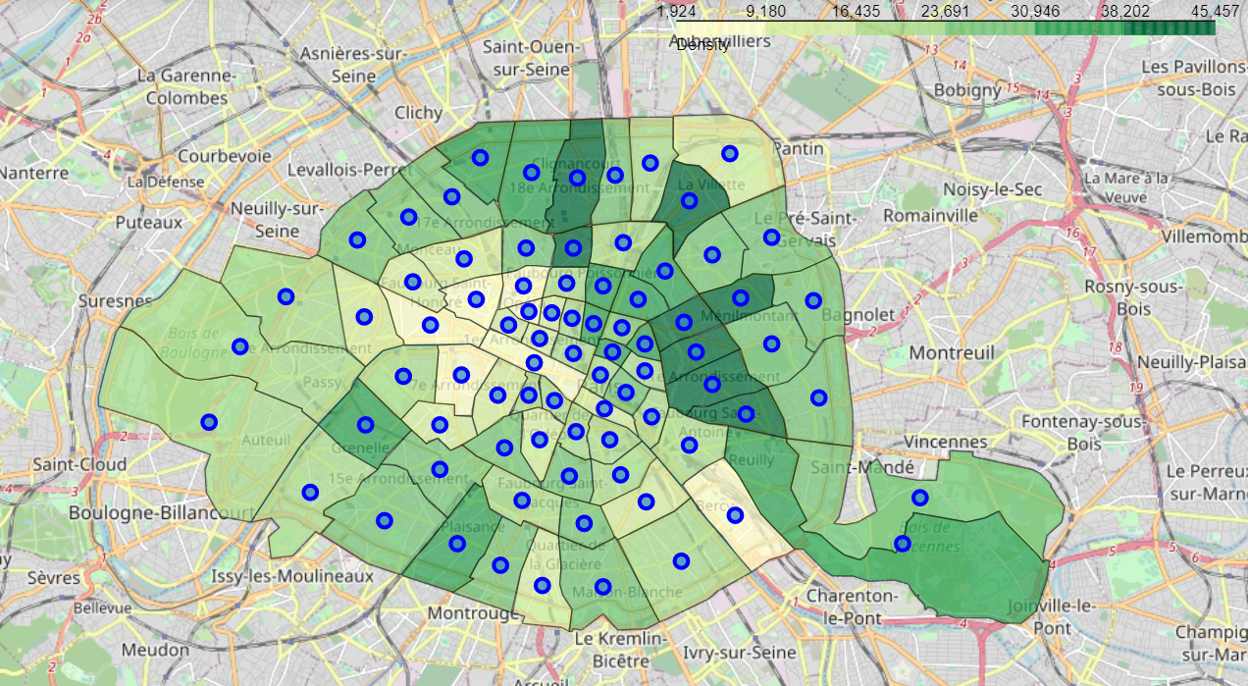
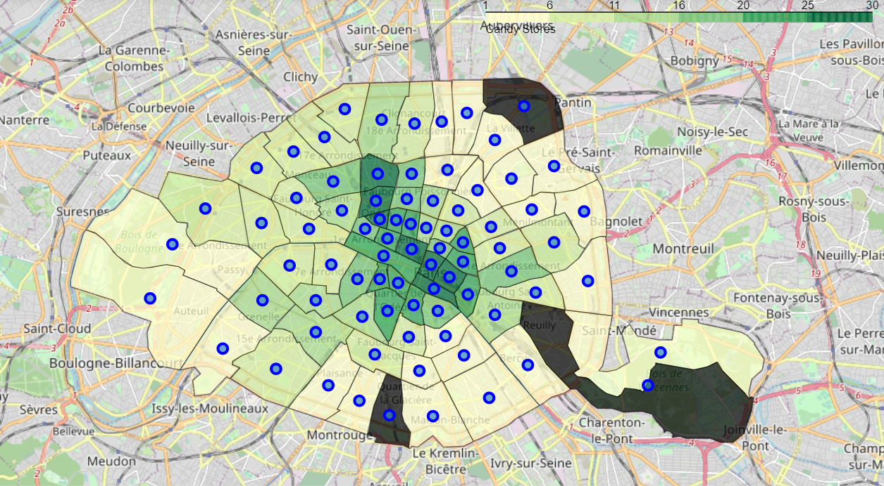
Density and Candy Stores in Paris neighborhoods
Density is high in the east of Paris.
The candy stores are strongly present in the center of Paris, in districts with fewer people.

Slide 5
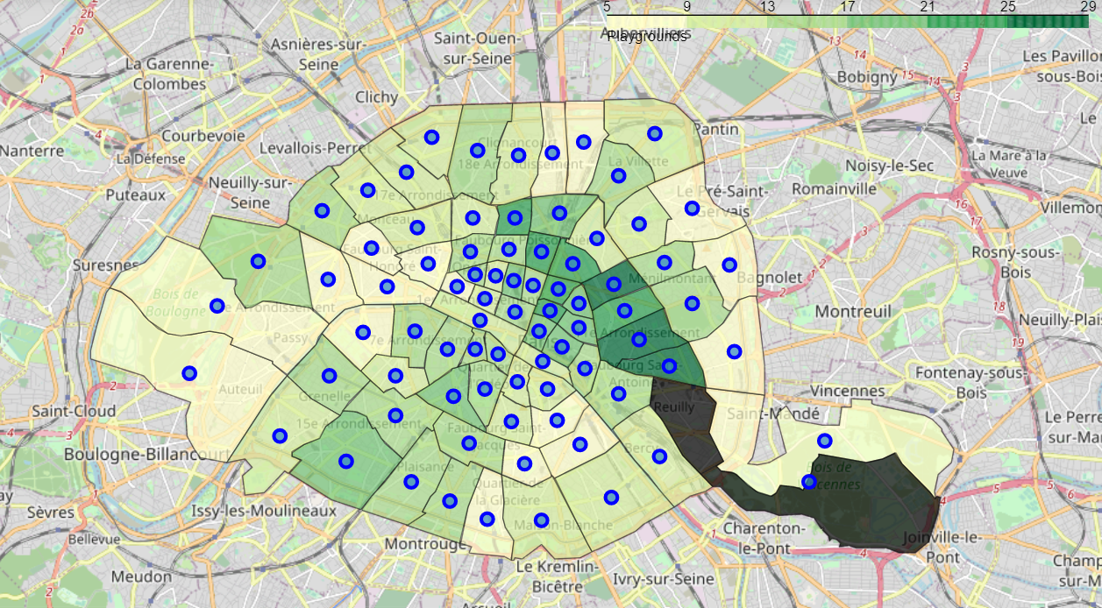
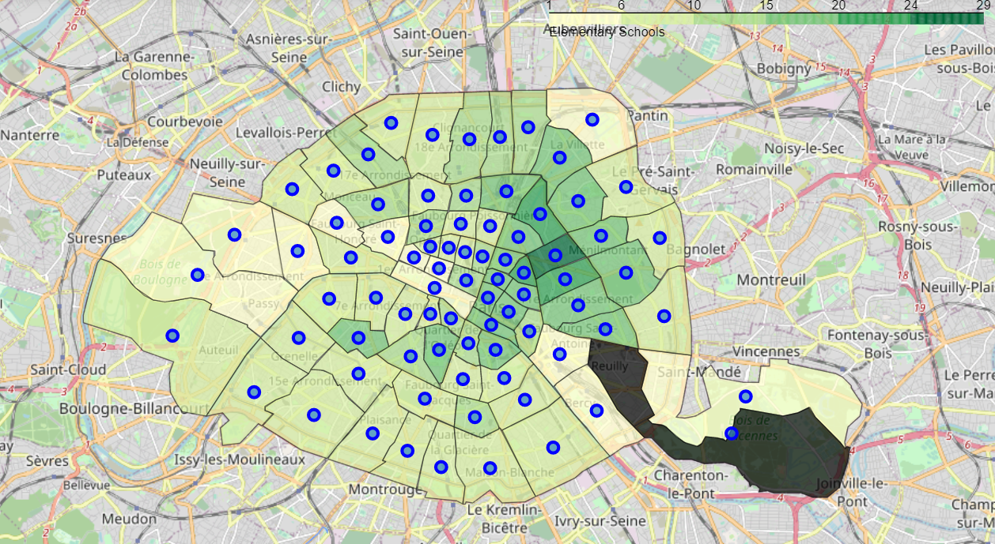
Elementary Schools and Playgrounds in Paris neighborhoods
Elementary schools and playgrounds are mostly located in the east of Paris and have a fairly similar density.

Slide 6
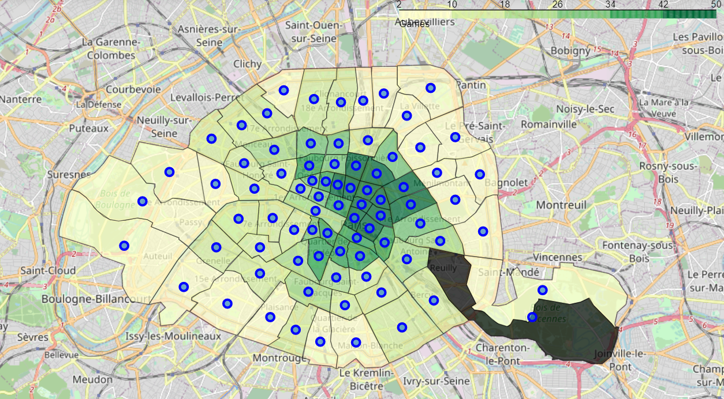
Toy/Games/Video Games Stores in Paris neighborhoods
Toys and games stores are more widely present, still located more east of Paris.

Slide 7
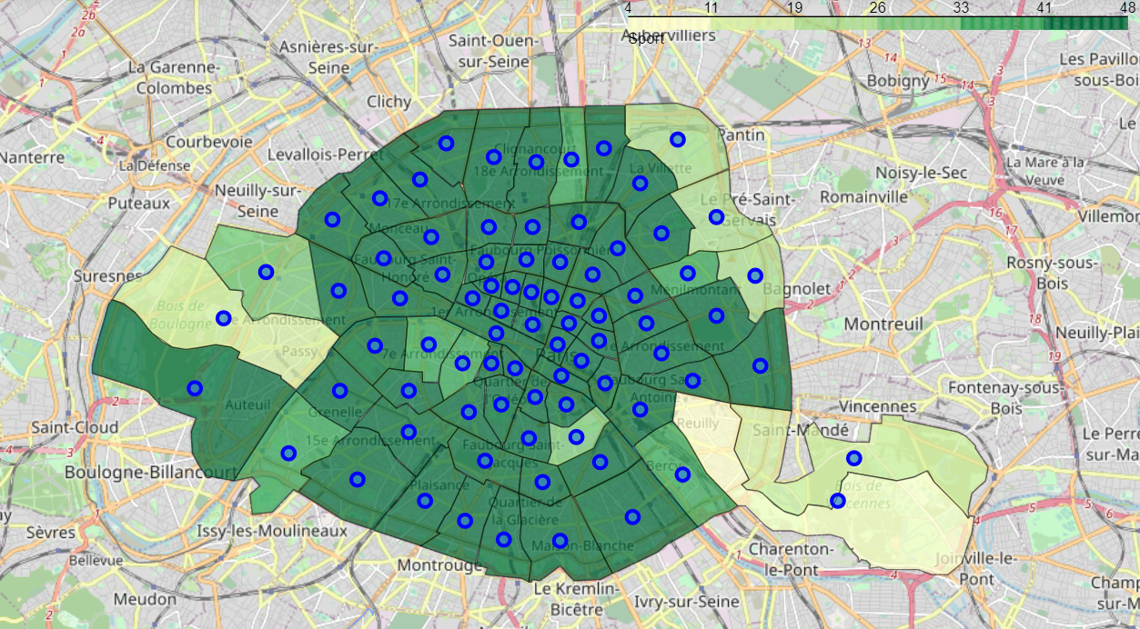
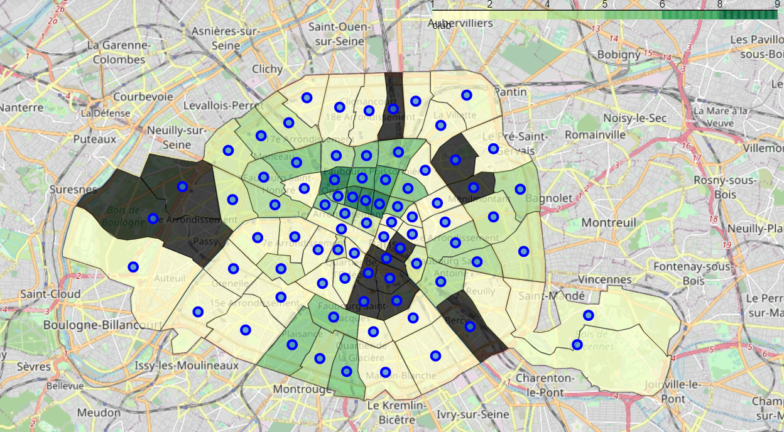
Athletics and Sports and Sport Clubs in Paris neighborhoods
Finally for sport, athletics and sports are present everywhere in the capital and are not a relevant indicator for the choice of the district. Conversely, sports clubs are present in the center of Paris.

Slide 8
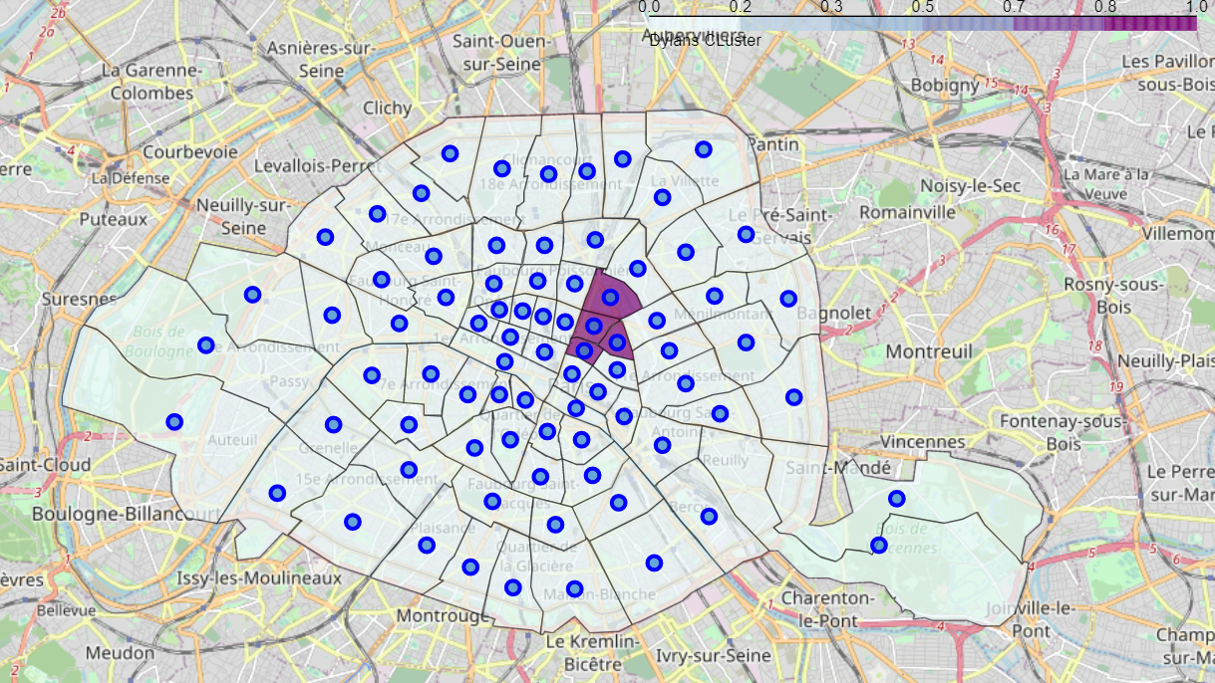
Paris neighborhoods in Dylan’s Stores Cluster
All the Dylan’s stores are in the same cluster with 4 districts of Paris.
They are at the crossroads of concentrations of elementary schools and playgrounds on one side, sports clubs on the other side and right in the middle of the concentration of games and toys shops.

Slide 9
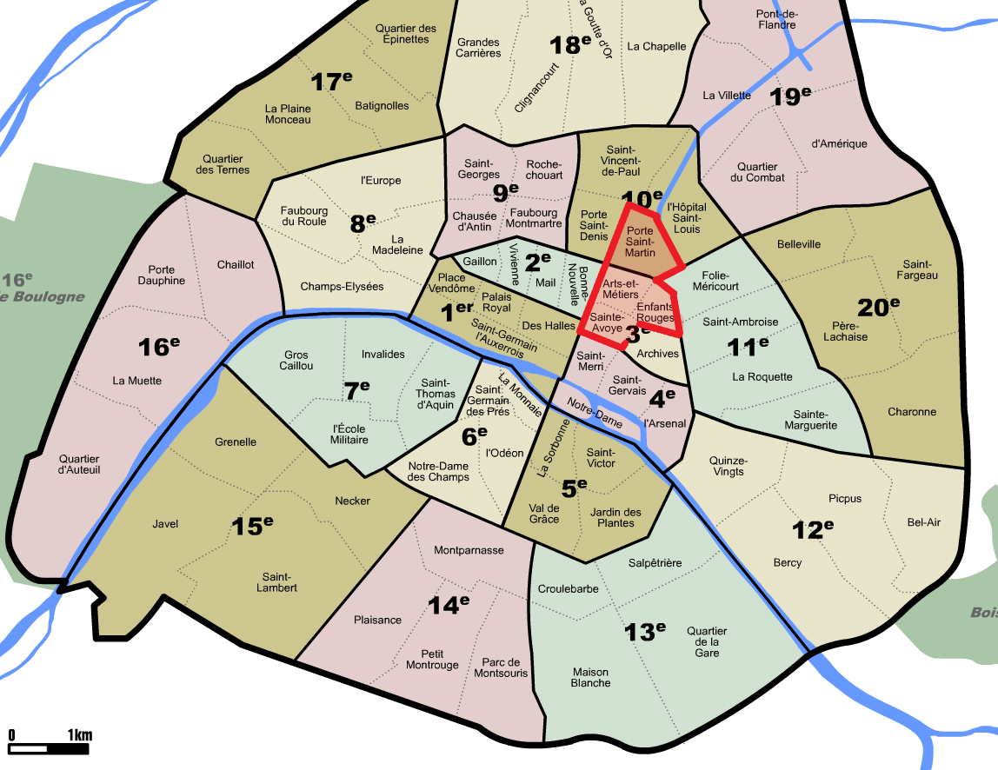
Conclusion
The recommendation and therefore the answer to the business problem is to open a candy bar in one of these four districts: Arts-et-Metiers, Enfants-Rouges, Porte-Saint-Martinand Sainte-Avoie. They are similar to the neighborhoods of Dylan’s bars in the United States and correspond to the initial analysis looking for the potential presence of children.

